Slide 2
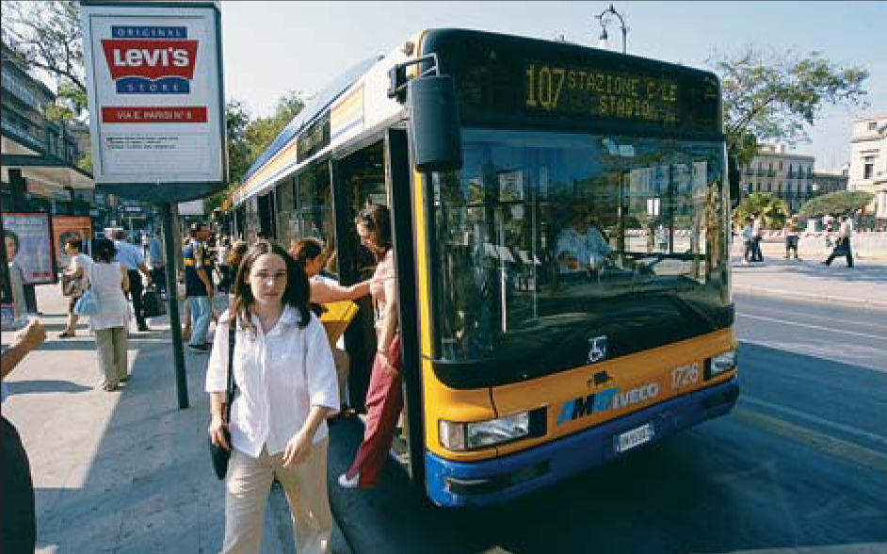
The Economic Problem:
Scarcity and Choice
2
Chapter Outline
Scarcity, Choice, and
Opportunity Cost
Scarcity and Choice in a
One-Person Economy
Scarcity and Choice in an
Economy of Two or More
The Production Possibility Frontier
Comparative Advantage
and the Gains from Trade
The Economic Problem
Economic Systems
Command Economies
Laissez-Faire Economies:
The Free Market
Mixed Systems, Markets,
and Governments
Looking Ahead

Slide 3
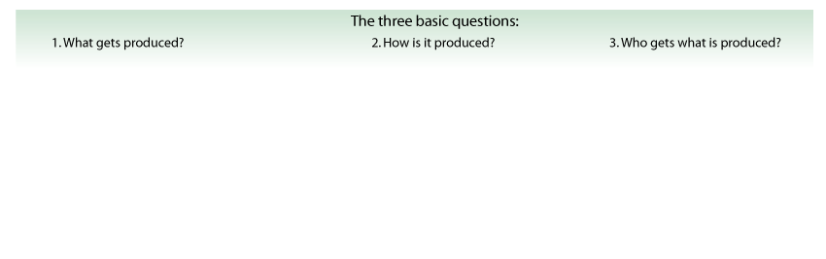


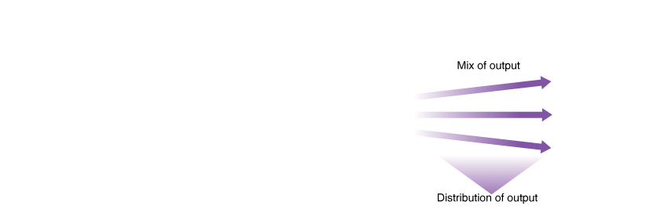

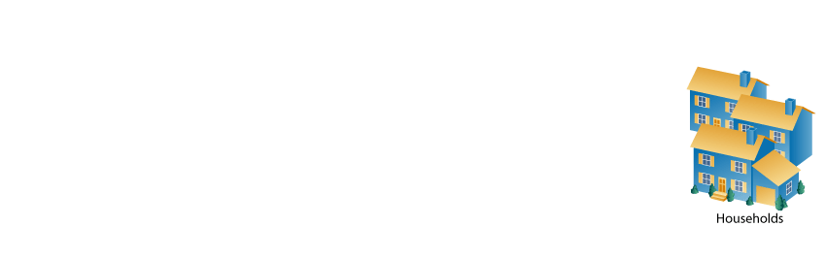
THE ECONOMIC PROBLEM:
SCARCITY AND CHOICE
FIGURE 2.1 The Three Basic Questions
Three basic questions must be answered in order to understand an economic system:
  What gets produced?
  How is it produced?
  Who gets what is produced?

Slide 4
THE ECONOMIC PROBLEM:
SCARCITY AND CHOICE
capital Things that are themselves produced and that are then used in the production of other goods and services.
factors of production (or factors) The inputs into the process of production. Another word for resources.

Slide 5
THE ECONOMIC PROBLEM:
SCARCITY AND CHOICE
production The process that transforms scarce resources into useful goods and services.
inputs or resources Anything provided by nature or previous generations that can be used directly or indirectly to satisfy human wants.
outputs Usable products.

Slide 6
SCARCITY, CHOICE, AND OPPORTUNITY COST
SCARCITY AND CHOICE IN A ONE-PERSON ECONOMY
Nearly all the same basic decisions that characterize complex economies must also be made in a simple
economy.

Slide 7
SCARCITY, CHOICE, AND OPPORTUNITY COST
Opportunity Cost
The concepts of constrained choice and scarcity are central to the discipline of economics.
opportunity costs The best alternative that we give up, or forgo, when we make a choice or decision.

Slide 8

SCARCITY, CHOICE, AND OPPORTUNITY COST
SCARCITY AND CHOICE IN AN ECONOMY OF TWO OR MORE
Education takes time. Time
spent in the classroom has
an opportunity cost.

Slide 9
SCARCITY, CHOICE, AND OPPORTUNITY COST
Specialization, Exchange, and Comparative Advantage
theory of comparative advantage Ricardo’s theory that specialization and free trade will benefit all trading parties,
even those that may be absolutely more efficient producers.

Slide 10
SCARCITY, CHOICE, AND OPPORTUNITY COST
absolute advantage A producer has an absolute advantage over another in the production of a good or service if it can produce that product using fewer resources.
comparative advantage A producer has a comparative advantage over another in the production of a good or service if it can produce that product at a
lower opportunity cost.

Slide 11
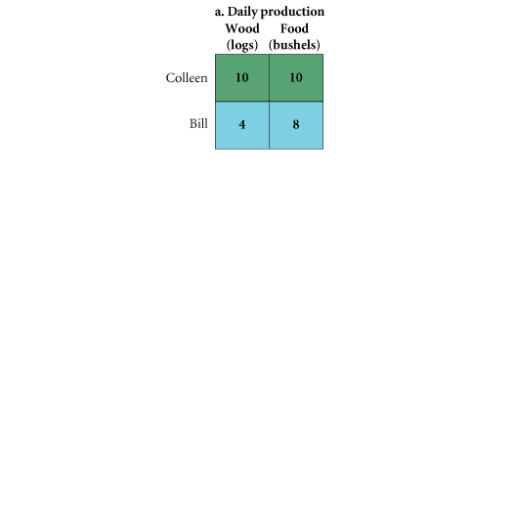
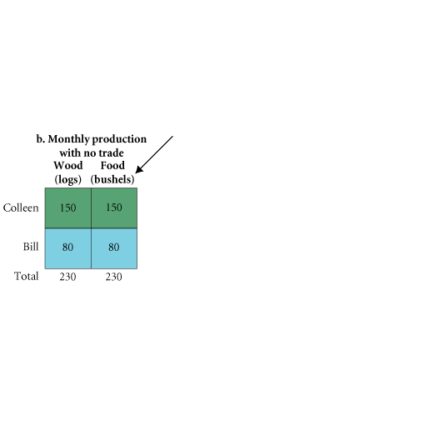
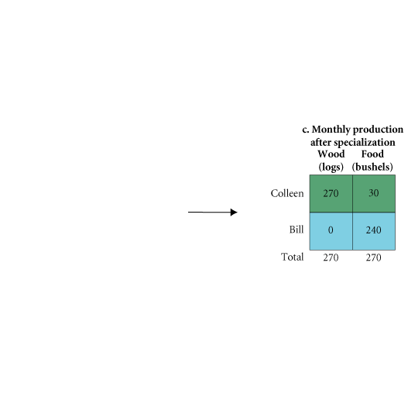
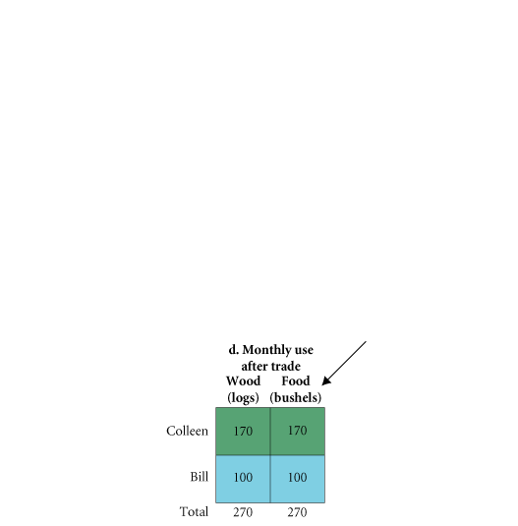
SCARCITY, CHOICE, AND OPPORTUNITY COST
FIGURE 2.2 Comparative Advantage and the Gains from Trade

Slide 12
SCARCITY, CHOICE, AND OPPORTUNITY COST
Weighing Present and Expected Future Costs and Benefits
We trade off present and future benefits in small ways all the time.

Slide 13
SCARCITY, CHOICE, AND OPPORTUNITY COST
Capital Goods and Consumer Goods
consumer goods Goods produced for present consumption.
investment The process of using resources to produce new capital.
Because resources are scarce, the opportunity cost of every investment in capital is forgone
present consumption.

Slide 14
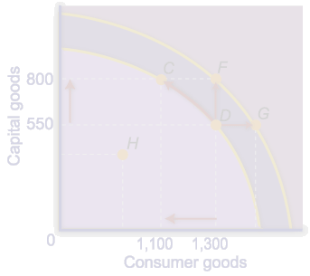
SCARCITY, CHOICE, AND OPPORTUNITY COST
THE PRODUCTION POSSIBILITY FRONTIER
production possibility frontier (ppf) A graph that shows all the combinations of
goods and services that can be produced if all of society’s resources are used efficiently.

Slide 15
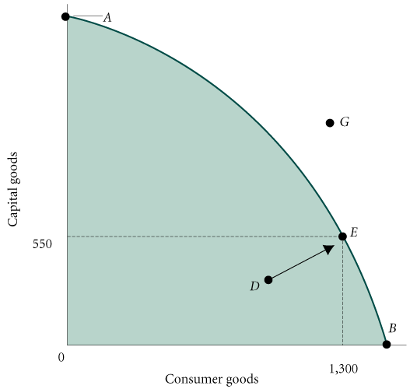
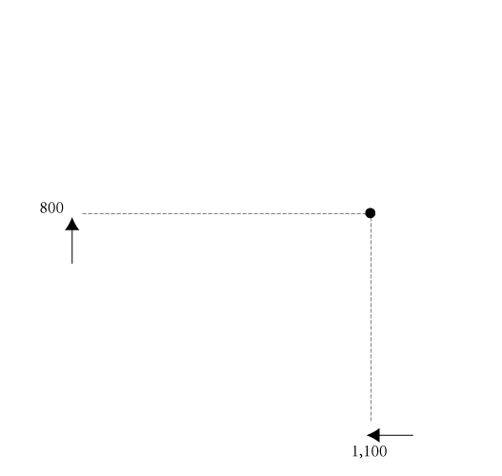
SCARCITY, CHOICE, AND OPPORTUNITY COST
FIGURE 2.3 Production Possibility Frontier

Slide 16
SCARCITY, CHOICE, AND OPPORTUNITY COST
Unemployment
During economic downturns or recessions, industrial plants run at less than their total capacity. When there is unemployment of labor and capital, we are not producing all that we can.

Slide 17
SCARCITY, CHOICE, AND OPPORTUNITY COST
Inefficiency
Waste and mismanagement are the results of a firm’s operating below its potential.
Sometimes, inefficiency results from mismanagement of the economy instead of mismanagement of individual private firms.
The Efficient Mix of Output
To be efficient, an economy must produce what people want.

Slide 18
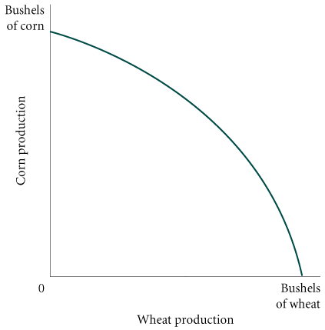
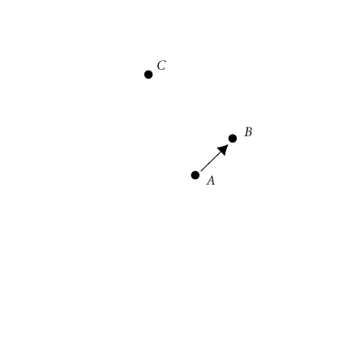
SCARCITY, CHOICE, AND OPPORTUNITY COST
Negative Slope and Opportunity Cost
marginal rate of transformation (MRT) The slope of the production possibility frontier (ppf).
FIGURE 2.4 Inefficiency from Misallocation
of Land in Farming

Slide 19
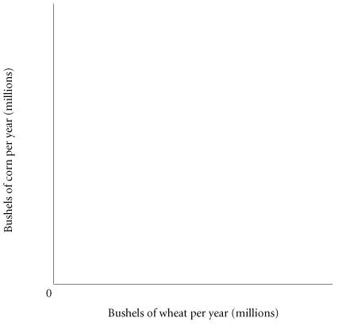

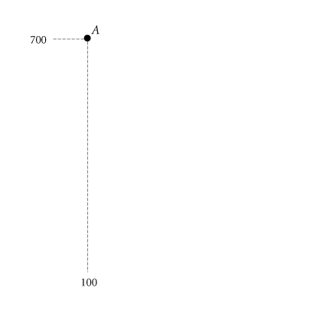
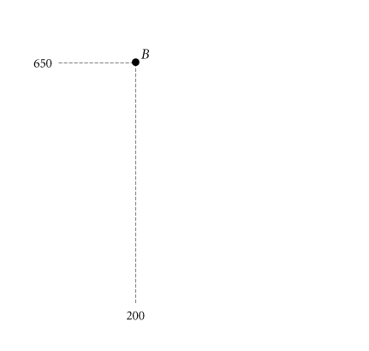
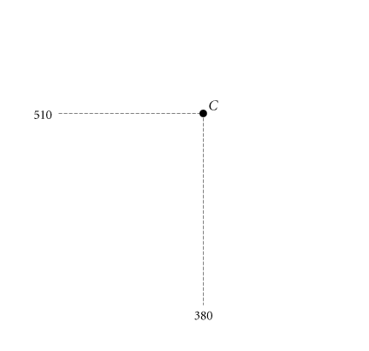
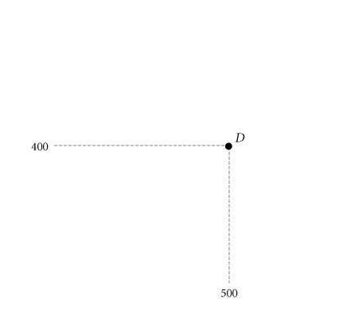
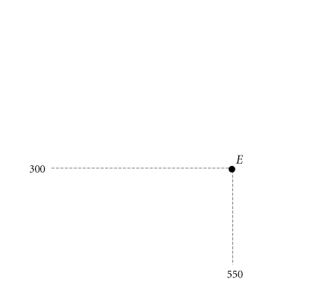
SCARCITY, CHOICE, AND OPPORTUNITY COST
The Law of Increasing Opportunity Cost
TABLE 2.1 Production Possibility Schedule for Total Corn and Wheat Production in Ohio and Kansas
POINT ON PPF | TOTAL CORN PRODUCTION (MILLIONS OF BUSHELS PER YEAR) | TOTAL WHEAT PRODUCTION (MILLIONS OF BUSHELS PER YEAR)
A | 700 | 100
B | 650 | 200
C | 510 | 380
D | 400 | 500
E | 300 | 550
FIGURE 2.5 Corn and Wheat Production in Ohio and Kansas

Slide 20
SCARCITY, CHOICE, AND OPPORTUNITY COST
Economic Growth
economic growth An increase in the total output of an economy. It occurs when a society acquires new resources or when it learns to produce more using existing resources.

Slide 21
SCARCITY, CHOICE, AND OPPORTUNITY COST
TABLE 2.2 Increasing Productivity in Corn and Wheat Production in the United States, 1935–2006
 | CORN |  | WHEAT
 | Yield Per Acre (Bushels) | Labor Hours Per 100 Bushels | Yield Per Acre (Bushels) | Labor Hours Per 100 Bushels
1935–1939 1945–1949 1955–1959 1965–1969 1975–1979 1981–1985 1985–1990 1990–1995 1998 2001 2006 | 26.1 36.1 48.7 78.5 96.3 107.2 112.8 120.6 134.4 138.2 145.6 | 108 53 20 7 4 3 NAª NAª NAª NAª NAª | 13.2 16.9 22.3 27.5 31.3 36.9 38.0 38.1 43.2 43.5 42.3 | 67 34 17 11 9 7 NAª NAª NAª NAª NAª

Slide 22
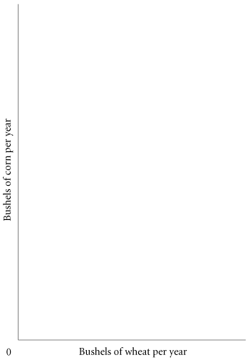
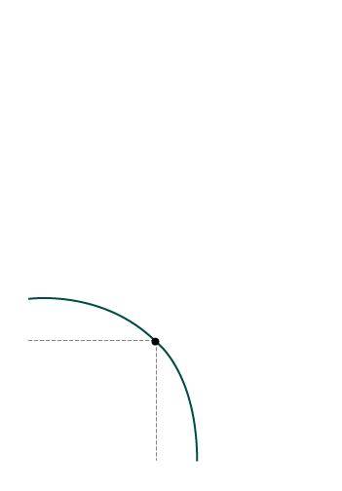
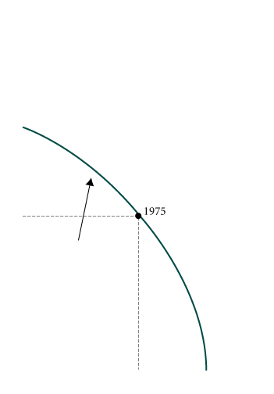
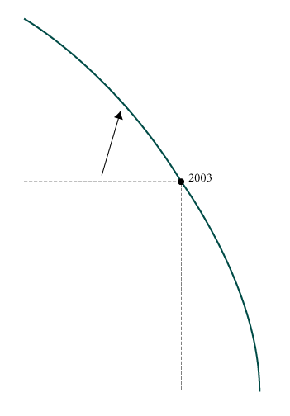
SCARCITY, CHOICE, AND OPPORTUNITY COST
FIGURE 2.6 Economic Growth Shifts the ppf Up and to the Right

Slide 23
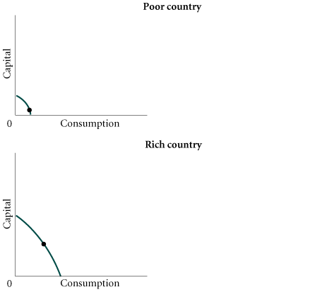
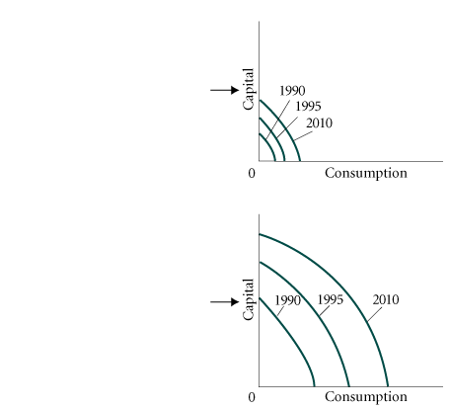
SCARCITY, CHOICE, AND OPPORTUNITY COST
Sources of Growth and the Dilemma of the Poor Countries
FIGURE 2.7 Capital Goods and Growth in Poor and Rich Countries

Slide 24
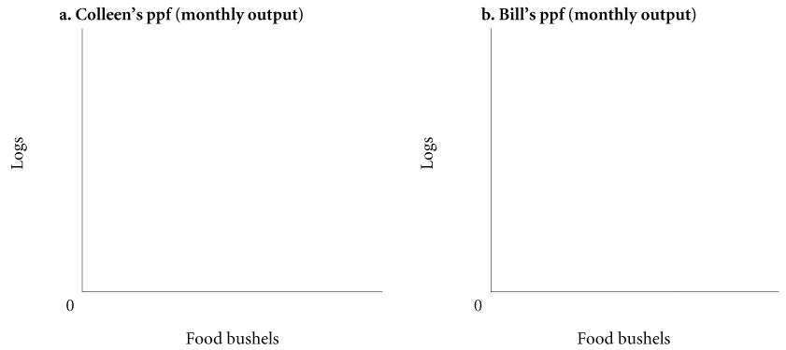

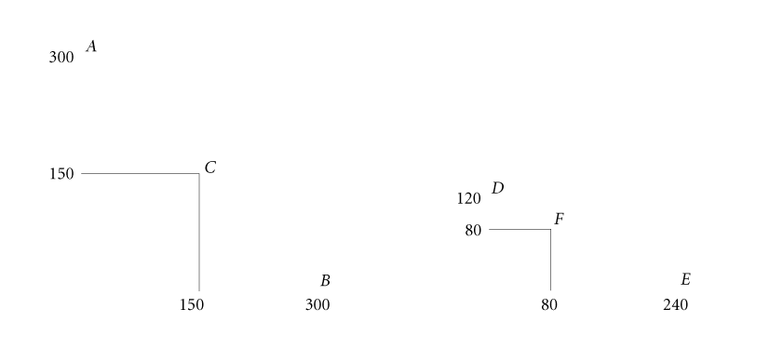
SCARCITY, CHOICE, AND OPPORTUNITY COST
COMPARATIVE ADVANTAGE AND THE GAINS FROM TRADE
FIGURE 2.8 Production Possibility Frontiers with No Trade

Slide 25
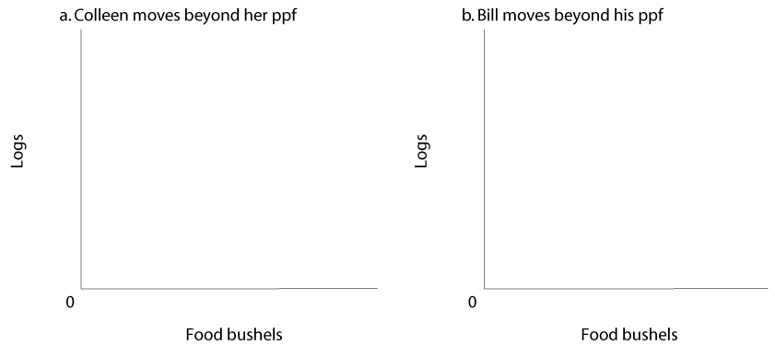
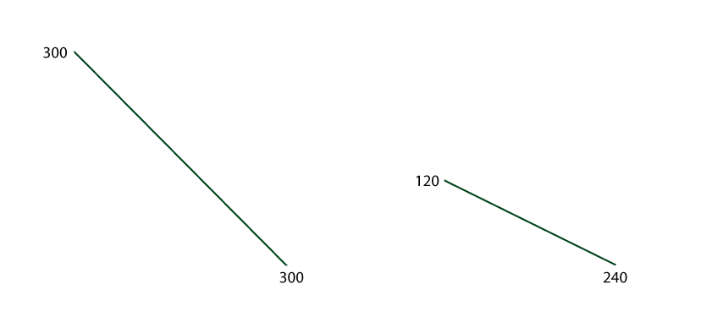
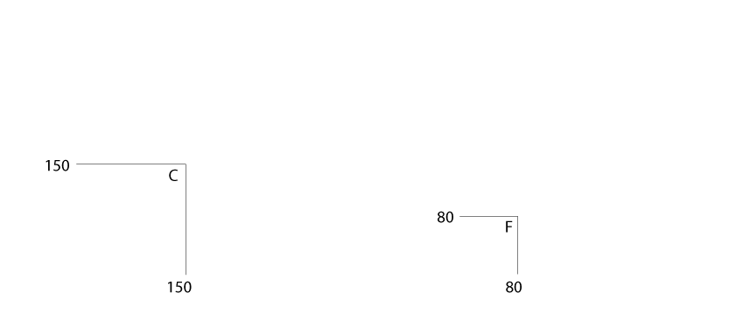
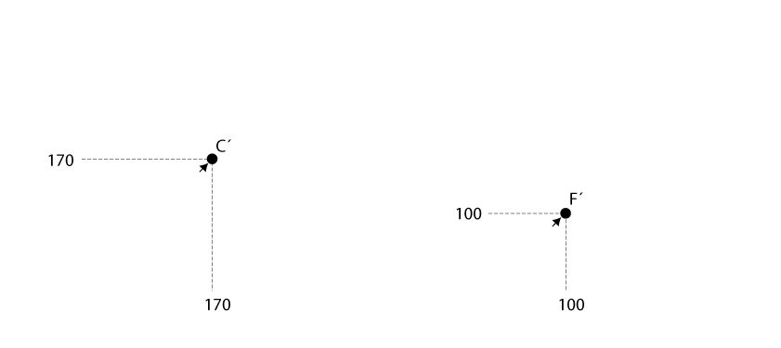
SCARCITY, CHOICE, AND OPPORTUNITY COST
FIGURE 2.9 Colleen and Bill Gain from Trade
Although it exists only as an abstraction, the ppf illustrates a number of very important
concepts that we shall use throughout the rest of this book: scarcity, unemployment,
inefficiency, opportunity cost, the law of increasing opportunity cost, economic
growth, and the gains from trade.

Slide 26
SCARCITY, CHOICE, AND OPPORTUNITY COST
THE ECONOMIC PROBLEM
Recall the three basic questions facing all economic systems:
(1) What gets produced?
(2) How is it produced?
(3) Who gets it?
Given scarce resources, how exactly do large, complex societies go about answering the three basic economic questions?

Slide 27
ECONOMIC SYSTEMS
COMMAND ECONOMIES
command economy An economy in which a central government either directly or indirectly sets output targets, incomes, and prices.

Slide 28
ECONOMIC SYSTEMS
LAISSEZ-FAIRE ECONOMIES: THE FREE MARKET
laissez-faire economy Literally from the French: “allow [them] to do.” An economy in which individual people and firms pursue their own self-interests without any central direction or regulation.
market The institution through which buyers and sellers interact and engage in exchange.
Some markets are simple and others are complex, but they all involve buyers and sellers
engaging in exchange. The behavior of buyers and sellers in a laissez-faire economy
determines what gets produced, how it is produced, and who gets it.

Slide 29
ECONOMIC SYSTEMS
Consumer Sovereignty
consumer sovereignty The idea that consumers ultimately dictate what will be produced (or not produced) by choosing what to purchase (and what not to purchase).

Slide 30
ECONOMIC SYSTEMS
Individual Production Decisions: Free Enterprise
free enterprise The freedom of individuals to start and operate private businesses in search of profits.

Slide 31
ECONOMIC SYSTEMS
Distribution of Output
The amount that any one household
gets depends on its income and wealth.
Income is the amount that a household earns each year. It comes in a number of forms: wages, salaries, interest, and the like.
Wealth is the amount that households have accumulated out of past income through saving or inheritance.

Slide 32
ECONOMIC SYSTEMS
Price Theory
New businesses arise each
day and some go out of business in response to profit opportunities and losses.
In a free market system, the basic economic questions are answered without the help of
a central government plan or directives. This is what the “free” in free market means—
the system is left to operate on its own, with no outside interference. Individuals pursuing
their own self-interest will go into business and produce the products and services
that people want. Others will decide whether to acquire skills; whether to work;
and whether to buy, sell, invest, or save the income that they earn. The basic coordinating
mechanism is price.

Slide 33
ECONOMIC SYSTEMS
MIXED SYSTEMS, MARKETS, AND GOVERNMENTS
The differences between command economies and laissez-faire economies in their pure forms are enormous. In fact, these pure forms do not exist in the world; all real systems are in some sense “mixed.”
Even staunch defenders of the free enterprise system recognize that market systems are not
perfect. First, they do not always produce what people want at lowest cost—there are inefficiencies. Second, rewards (income) may be unfairly distributed, and some groups may be left out. Third, periods of unemployment and inflation recur with some regularity.

Slide 34
REVIEW TERMS AND CONCEPTS
absolute advantage
capital
command economy
comparative advantage
consumer goods
consumer sovereignty
economic growth
factors of production (or factors)
free enterprise
inputs or resources
investments
laissez-faire economy
marginal rate of transformation (MRT)
market
opportunity cost
outputs
production
production possibility frontier (ppf)
theory of comparative advantage

